Slide 1

Capstone Project Presentation
Battle of Neighborhoods (Week 2)

Slide 2
Introduction: Business Problem ¶ in New York City In this project we will use data science tools to identify which borough in New York City has the most unique places to visit.

Slide 3
Target audience
people looking to explore unique places to visit New York City

Slide 4
Background of the problem
people looking to explore unique places in New York City usaully dont know which borough in New York City to visit that the most unique places in New York City

Slide 5
Data to be used for project
foursquare location data (Borough,Borough Latitude,Borough Longitude,Venue,Venue Latitude,Venue Longitude,Venue Category)

Slide 6
Libraries used for project
requests(library to handle requests),pandas(library for data analsysis),numpy(library to handle data in a vectorized manner),random(library for random number generation),Nominatim(module to convert an address into latitude and longitude values),Image&HTML(libraries for displaying images),json_normalize(tranforming json file into a pandas dataframe library),folium(plotting library)

Slide 7
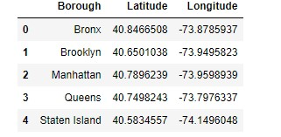
Created a dataframe containing name and location of all the boroughs of New York

Slide 8
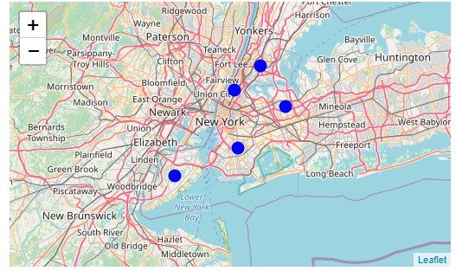
Plotted out map of New York Boroughs

Slide 9
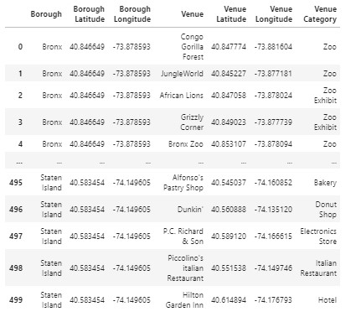
Used Foursquare api to retrieve location data on boroughs giving us the Borough,borough latitude, borough longitude, venue,venue latitude, venue longitude and venue category then converted I formation into dataframe below

Slide 10
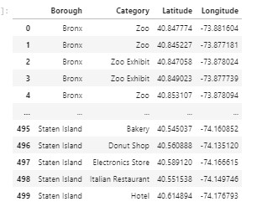
Created a new dataframe containing the only relevant I formation we needed like Borough,category longitude and latitude of venue

Slide 11
Found out there is 155 unique places in New York City

Slide 12
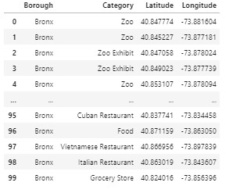
Created a new data frame for the Bronx To determine how many unique places does the Bronx have

Slide 13
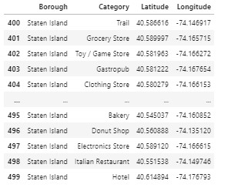
Created a new data frame for the Staten Island To determine how many unique places does the Staten Island have

Slide 14
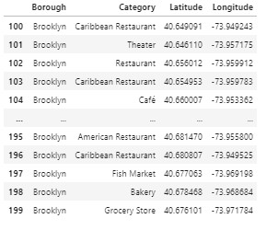
Created a new data frame for the Brooklyn To determine how many unique places does the Brooklyn have

Slide 15
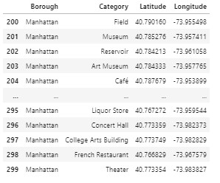
Created a new data frame for the Manhattan To determine how many unique places does the Manhattan have

Slide 16
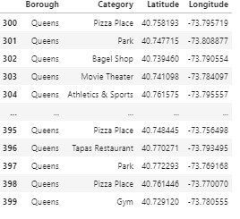
Created a new data frame for the Queens To determine how many unique places does the Queens have

Slide 17

Took each boroughs unique place count and Created another dataframe containing the total unique places under each borough

Slide 18
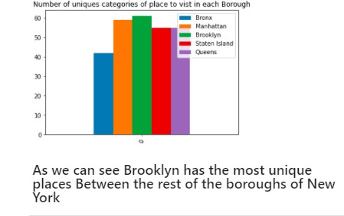
Used the information on the previous datafram to create a bar chart to check which borough has the most unique places

